Slide 1
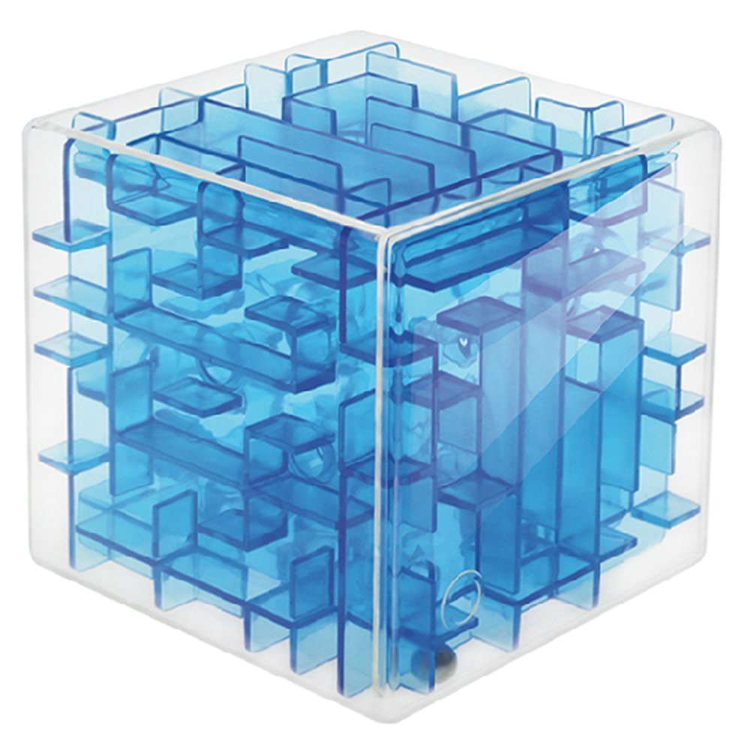
3D Maze

Slide 2
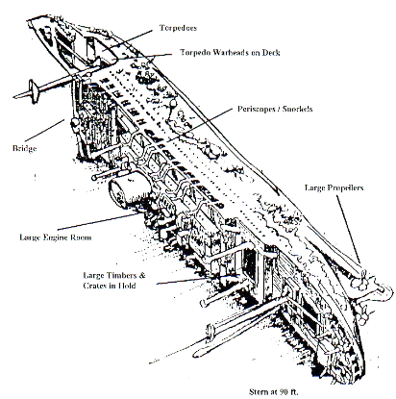
3D Maze
"Two Scuba diving buddies have encountered a large, box-shaped storage facility inside the hull of the Heian Maru, a 512' submarine tender lying on the bottom of Truk Lagoon at 108'.
The storage facility is composed of cells, some of which can be entered and some which cannot. The only exterior walls that are missing are on the front of the storage facility in the upper left corner, and on the rear of the storage facility in the lower right corner.
The divers wish to determine a path through the storage facility. Use recursion to find a path through the maze or to prove that there is no path."

Slide 3
Finding a Path through a Maze
Problem
Use backtracking to find and display the path through a maze.
From each point in a maze you can move to the next cell in a horizontal or vertical direction if the cell is not blocked.
Analysis
The maze will consist of an array of cells.
The starting point is at the top left corner maze[0][0][0].
The exit point is at the bottom right corner, that is
maze[HEIGHT - 1][WIDTH - 1][LAYERS - 1].
All cells on the path will have a OPEN value.
All cells that represent barriers will have a BLOCKED value.
Cells that we have visited will have a TEMPORARY value.
If we find a path through the maze, the exit cell value will be EXIT and all cells on the path will have the PATH value.

Slide 4
Sample test files
Input File
in_01.txt
in_02.txt
in_03.txt
Output File
out_01.txt
out_02.txt
out_03.txt

Slide 5
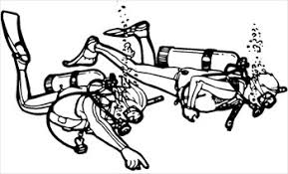
The Maze Layout
The maze size is defined by layer * height * width as specified on the first line of the test file.
Width
Left Right
START 0,0,0 | 0,1,0 | 0,2,0 | 0,3,0
1,0,0 | 1,1,0 | 1,2,0 | 1,3,0
2,0,0 | 2,1,0 | 2,2,0 | 2,3,0
3,0,0 | 3,1,0 | 3,2,0 | 3,3,0
Layer
Out IN
0,0,1 | 0,1,1 | 0,2,1 | 0,3,1
1,0,1 | 1,1,1 | 1,2,1 | 1,3,1
2,0,1 | 2,1,1 | 2,2,1 | 2,3,1
3,0,1 | 3,1,1 | 3,2,1 | 3,3,1
Height
Down Up
0,0,2 | 0,1,2 | 0,2,2 | 0,3,2
1,0,2 | 1,1,2 | 1,2,2 | 1,3,2
2,0,2 | 2,1,2 | 2,2,2 | 2,3,2
3,0,2 | 3,1,2 | 3,2,2 | 3,3,2
0,0,3 | 0,1,3 | 0,2,3 | 0,3,3
1,0,3 | 1,1,3 | 1,2,3 | 1,3,3
2,0,3 | 2,1,3 | 2,2,3 | 2,3,3
3,0,3 | 3,1,3 | 3,2,3 | EXIT 3,3,3

Slide 6
The Maze Layout
The maze size is defined by layer * height * width as specified on the first line of the test file.
Width
Left Right
0 (START) | 0 (Open) | 0 (Open) | 0 (Open)
0 (Open) | 1 (Blocked) | 1 (Blocked) | 1 (Blocked)
0 (Open) | 1 (Blocked) | 1 (Blocked) | 1 (Blocked)
0 (Open) | 1 (Blocked) | 1 (Blocked) | 1 (Blocked)
Layer
Out IN
0 (Open) | 0 (Open) | 0 (Open) | 1 (Blocked)
1 (Blocked) | 1 (Blocked) | 1 (Blocked) | 1 (Blocked)
1 (Blocked) | 1 (Blocked) | 1 (Blocked) | 1 (Blocked)
0 (Open) | 1 (Blocked) | 1 (Blocked) | 1 (Blocked)
Height
Down Up
0 (Open) | 0 (Open) | 1 (Blocked) | 0 (Open)
0 (Open) | 1 (Blocked) | 1 (Blocked) | 0 (Open)
0 (Open) | 1 (Blocked) | 1 (Blocked) | 1 (Blocked)
0 (Open) | 1 (Blocked) | 1 (Blocked) | 1 (Blocked)
1 (Blocked) | 0 (Open) | 1 (Blocked) | 1 (Blocked)
1 (Blocked) | 0 (Open) | 1 (Blocked) | 1 (Blocked)
1 (Blocked) | 0 (Open) | 1 (Blocked) | 1 (Blocked)
1 (Blocked) | 0 (Open) | 0 (Open) | 0 (Exit)

Slide 7
The Maze Layout (Bonus)
Maze values tell which way to proceed thru the maze ("L", "R", "U", "D", "O", or "I".)
Width
Left Right
R (Right) | R (Right) | I (In) | 0 (Open)
0 (Open) | 1 (Blocked) | 1 (Blocked) | 1 (Blocked)
0 (Open) | 1 (Blocked) | 1 (Blocked) | 1 (Blocked)
0 (Open) | 1 (Blocked) | 1 (Blocked) | 1 (Blocked)
Layer
Out IN
I (In) | L (Left) | L (Left) | 1 (Blocked)
1 (Blocked) | 1 (Blocked) | 1 (Blocked) | 1 (Blocked)
1 (Blocked) | 1 (Blocked) | 1 (Blocked) | 1 (Blocked)
0 (Open) | 1 (Blocked) | 1 (Blocked) | 1 (Blocked)
Height
Down Up
R (Right) | I (In) | 1 (Blocked) | 0 (Open)
0 (Open) | 1 (Blocked) | 1 (Blocked) | 0 (Open)
0 (Open) | 1 (Blocked) | 1 (Blocked) | 1 (Blocked)
0 (Open) | 1 (Blocked) | 1 (Blocked) | 1 (Blocked)
1 (Blocked) | D (Down) | 1 (Blocked) | 1 (Blocked)
1 (Blocked) | D (Down) | 1 (Blocked) | 1 (Blocked)
1 (Blocked) | D (Down) | 1 (Blocked) | 1 (Blocked)
1 (Blocked) | R (Right) | R (Right) | E (Exit)

Slide 8
Requirements
Your maze program outputs the solution path using 'L' for move left (width - 1), 'R' for move right (width + 1), 'U' for move up on the same layer (height - 1), 'D' for move down on the same layer (height + 1), 'O' for move to the previous layer (layer - 1), and 'I' for move to the next layer (layer + 1). In addition, 'E' indicates the exit point.

Slide 9


